Slide 1
Notes:
[Blank slide] … preptalk about the experiment …

Slide 2
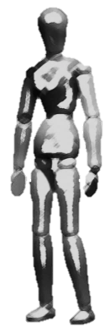
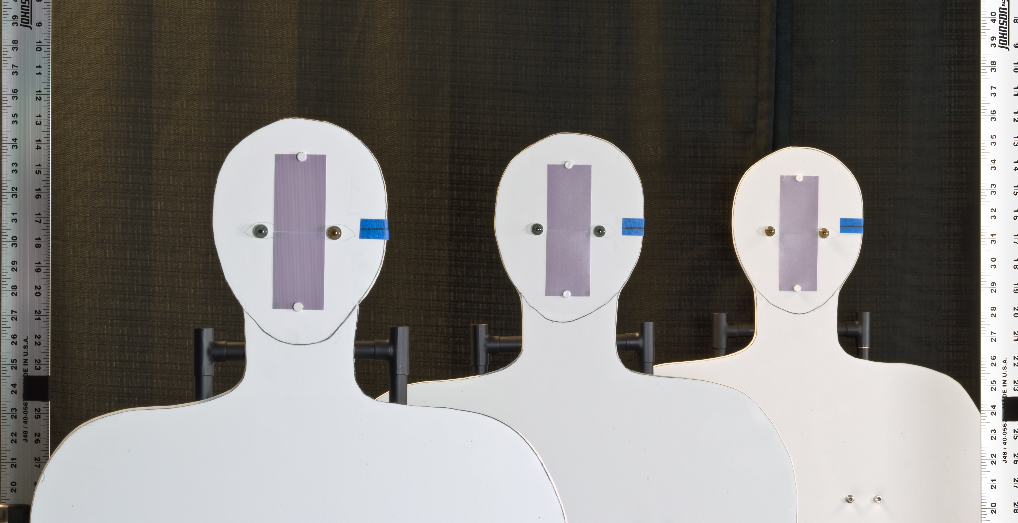
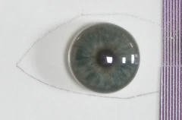
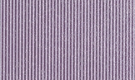
Demonstration of capture volume improvement using AFS in the laboratory
0.61 m
0.61 m
4.04 m
Setup #1
rear
middle
180 mm, F/8
near
Artificial iris
3.43 m
4.04 m
4.65 m
Ø 11 mm
Camera’s view
Pattern (2 lp/mm)
mm

Slide 3
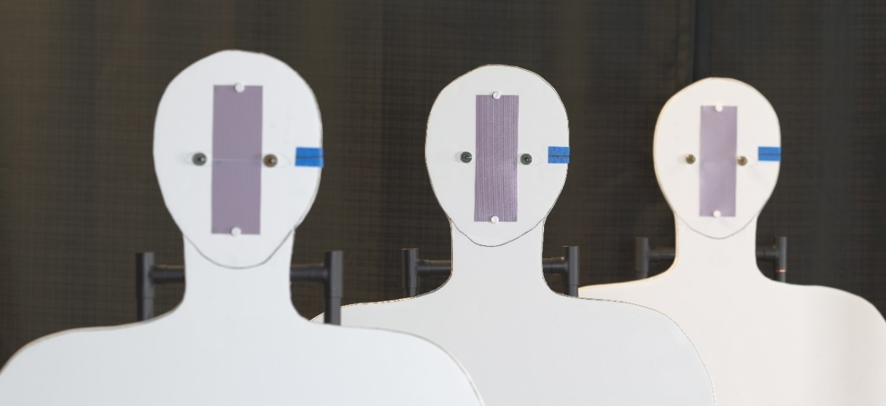
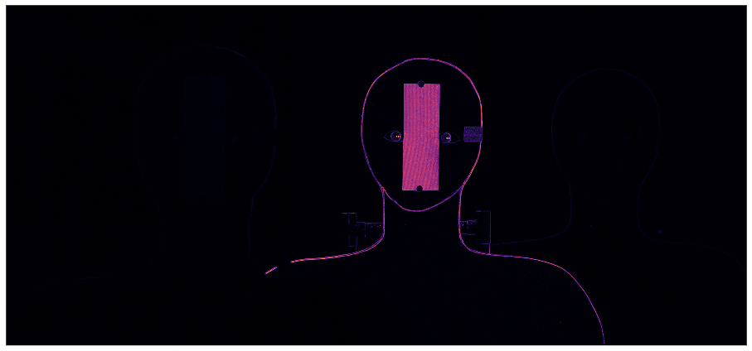
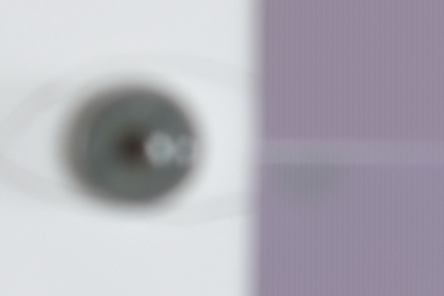
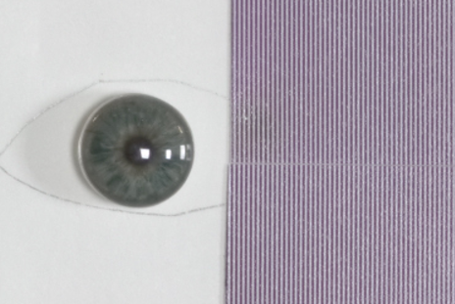
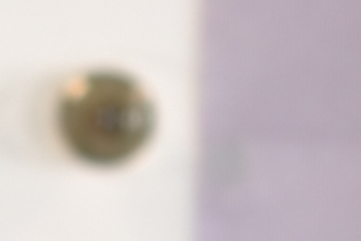
Traditional image capture with large aperture results in shallow DOF
Aperture: F/8 Exposure time: 0.77 sec Focused on: 4.04 m DOF: approx. 30 cm (for 2 lp/mm)
3.43 m
4.04 m
4.65 m
Focus measure
Notes:
Mention that the patches has been scaled differently to match ???

Slide 4
Strategy for capture AFS images
180 mm, F/8 lens tilted b/w -16° & -19° in increments of 0.5° about the entrance pupil center
Notes:
How to determine the angles
How to determine the image plane distance
How to determine
A line on how to restore the COP …
Empirically we found d = -5

Slide 5
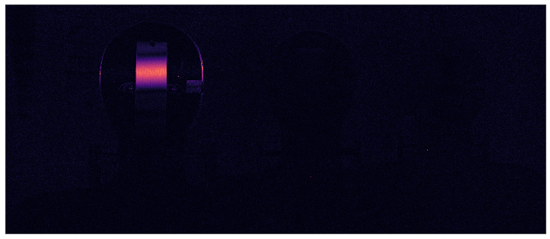
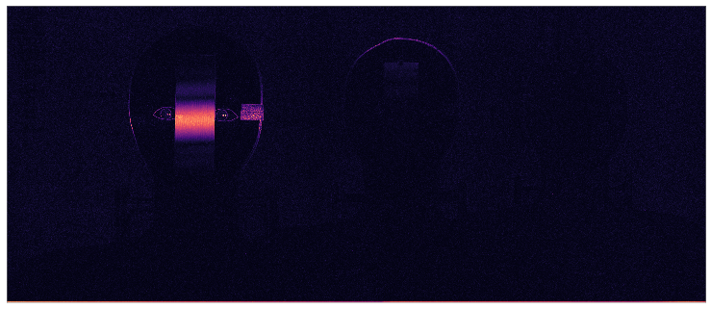
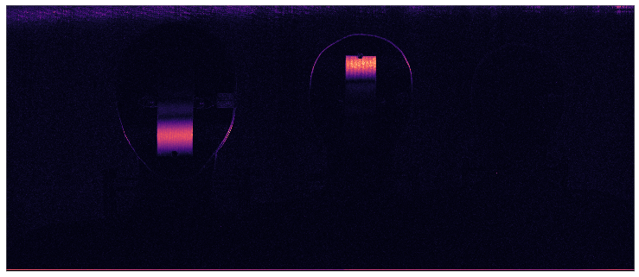
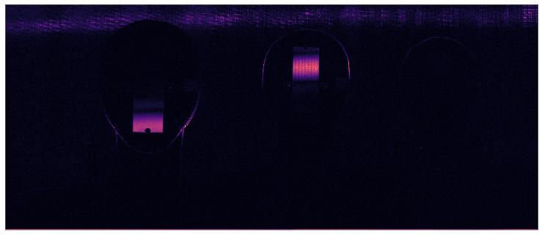
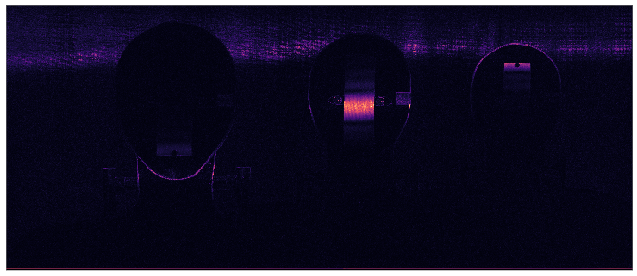
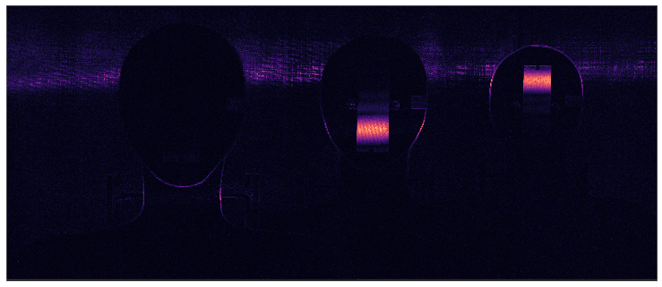
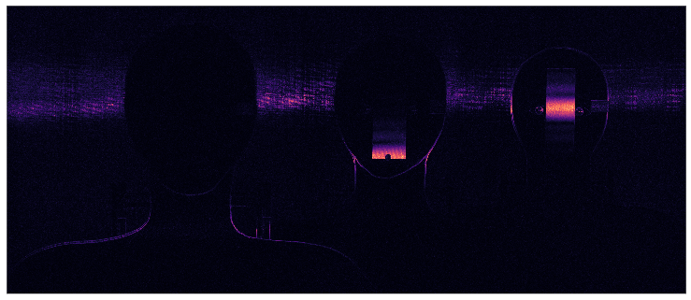







Focused regions in the images detected using LoG filter shows different regions of the scene in focus
$$α=−{16.0}^{o}$$
$$α=−{16.5}^{o}$$
$$α=−{17.0}^{o}$$
$$α=−{17.5}^{o}$$
$$α=−{18.0}^{o}$$
$$α=−{18.5}^{o}$$
$$α=−{19.0}^{o}$$
Notes:
Mention that these are “registered” images in the focal stack

Slide 6
The focused regions overlaid on intensity images shows
rotating the lens induces a rotation of the DOF in the object space

Slide 7
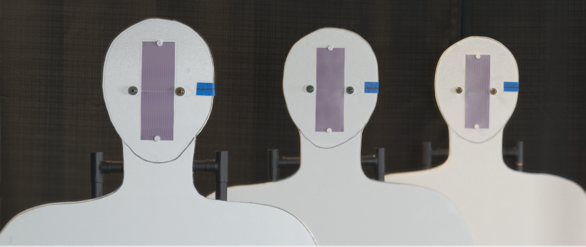
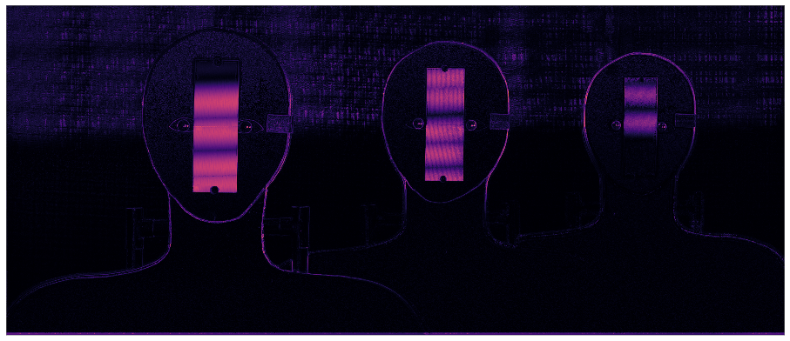
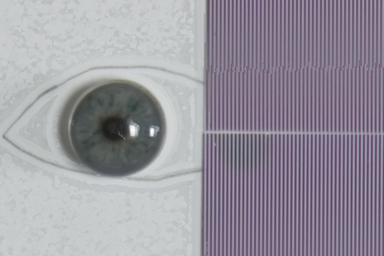
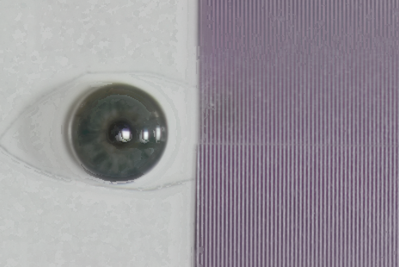
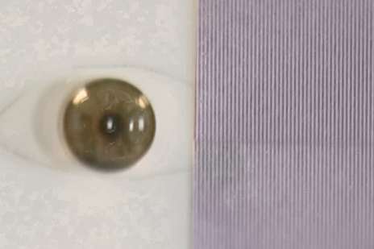
AFS composite image shows DOF extended beyond 1.2 meters
Aperture: F/8 (each image) Total exposure time: 5.4 sec DOF: greater than 1.2 m (for 2 lp/mm)
3.43 m
4.04 m
4.65 m
Focus measure
Adjustment errors causes registration errors
Notes:
Talk about the registration errors arising from the uncertainties of the experiment.

Slide 8
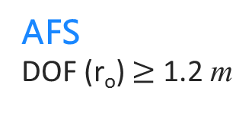
AFS produces at least 4x more DOF than conventional imaging
for a r_{o} = 2 lp/mm target at 4 m
Near (3.43 m)
Middle (4.04 m)
Far (4.65 m)
Conventional at F/8
DOF (r_{o}) = 29 cm
AFS
DOF (r_{o}) $≥$ 1.2 m
Notes:
Mention that the patches has been scaled differently to match ???

Slide 9
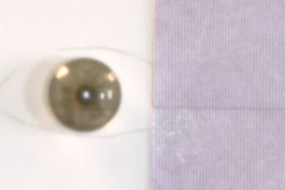
AFS is faster than conventional capture for equivalent DOF & exposure level. Therefore, subjects are less constrained within the extended capture volume.
Near (3.43 m )
Middle (4.04 m )
Far (4.65 m )
Conventional at F/22
T = 8 sec.
AFS
Total T = 5 sec.
Each T = 0.77 sec.
Notes:
Since the main comparision here is for the total time … I can probably scale the images of the eye patches

Slide 10
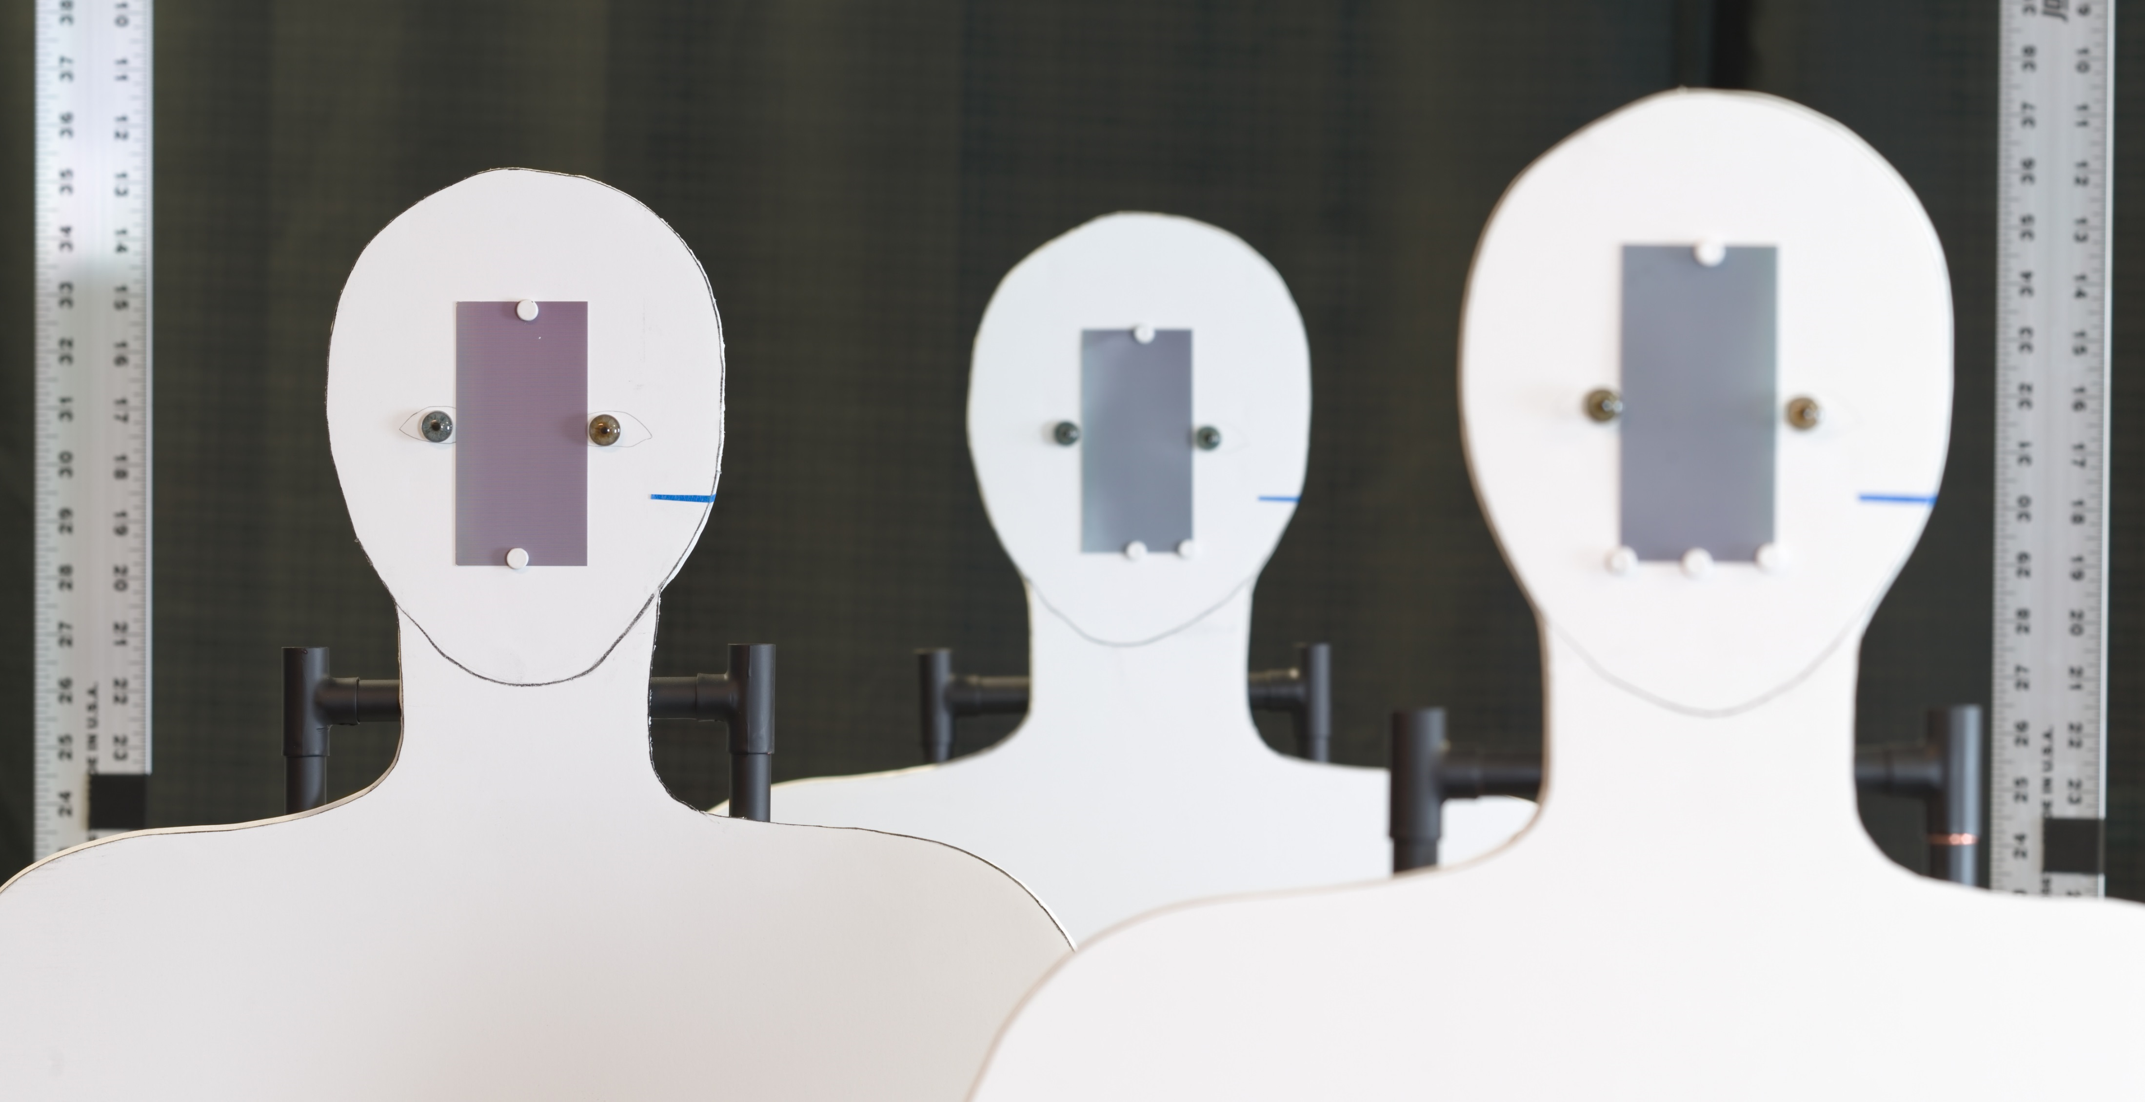
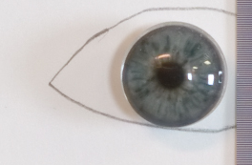
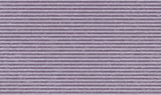
Could we push a
0.61 m
0.61 m
0.61 m
0.61 m
4.04 m
3.43 m
Setup #2
Setup #1
rear
middle
near
180 mm, F/8
rear
middle
near
3.43 m
4.04 m
2.82 m
Artificial iris
Ø 11 mm
Camera’s view
Pattern (3.94 lp/mm)

Slide 11
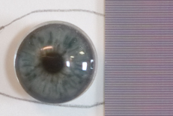
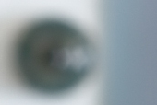
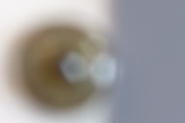
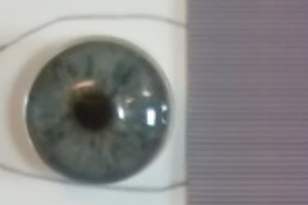
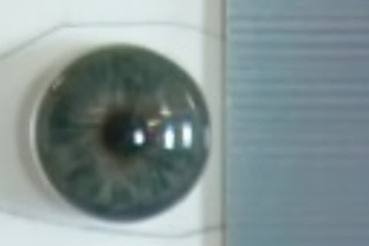
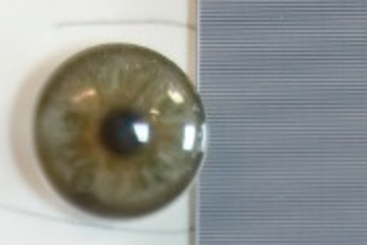
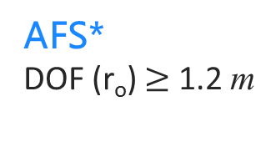
AFS with 14 focal stack images resulted 9.8x DOF than conventional imaging
for a r_{o} = 3.94 lp/mm target at 3.43 m
Middle (3.43 m)
Far (4.04 m)
Near (2.82 m)
Conventional at F/8
DOF (r_{o}) = 12.5 cm
AFS*
DOF (r_{o}) $≥$ 1.2 m
*In this example, the focal stack images, after registration, were fused using Helicon focus.
Notes:
Mention that the patches has been scaled differently to match ???

Slide 13
We can concluded that.
Notes:
Conclusion from the slide
Two parts (horizontally separated)
Just two sets of horizontal bar plots.
Compared to conventional imaging | Compared to the state-of-the art
How much DOF extension
Better in

